Slide 1
Keeping Our Oceans Clean
Presented by:

Slide 2
Understanding Our Oceans
Oceans cover over 70% of Earth’s surface
Oceans produce over half of the world's oxygen

Slide 3
The Lifeline of Our Planet
Oceans support diverse marine ecosystems,
regulate our climate,
and are essential for food security
What do they do for us?

Slide 4
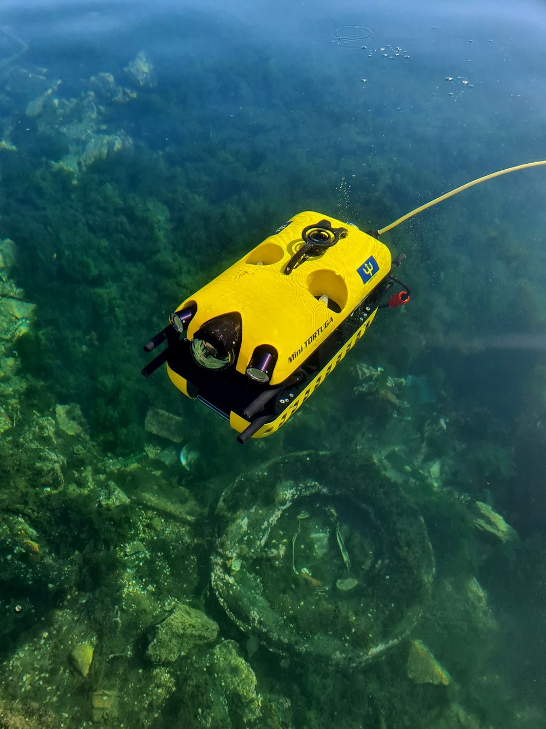
What is Ocean Pollution?
Ocean pollution: Contamination of the ocean
Common pollutants: Plastic waste, industrial runoff, oil spills
Can you spot it in the image?

Slide 5
What Pollutes Our Oceans?
Major sources: 70-80% land-based, 20-30% maritime waste
Everyday culprits: Plastic bottles, bags, industrial waste

Slide 6
Let’s reflect
What single-use items you used yesterday?

Slide 7
How long things take to break down (in years)

Slide 8
How Does Pollution Get into the Sea?
Land runoff (when it rains)
Direct discharge into waterways
Gases from cars, factories, and agriculture
Marine activities: shipping, fishing, and offshore drilling
Beach littering

Slide 9
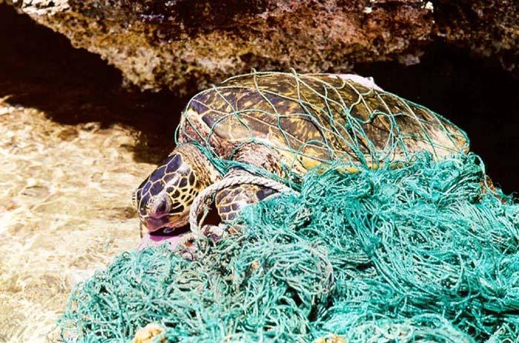
Marine Life and Pollution
By 2050, more plastic than fish by weight
Coral reefs are dying due to pollution
Sea animals have a small quantity of plastic inside (microplastics)
A sea turtle entangled in an abandoned fishing net. Credit: NOAA

Slide 10
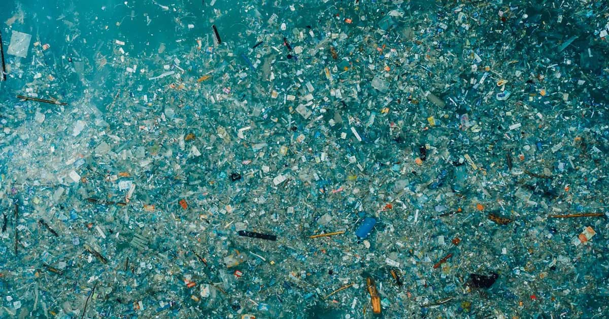
A Floating Disaster
The Great Pacific Garbage Patch
Contains over 1.8 trillion pieces of debris
Credit: cleanhub.com

Slide 11
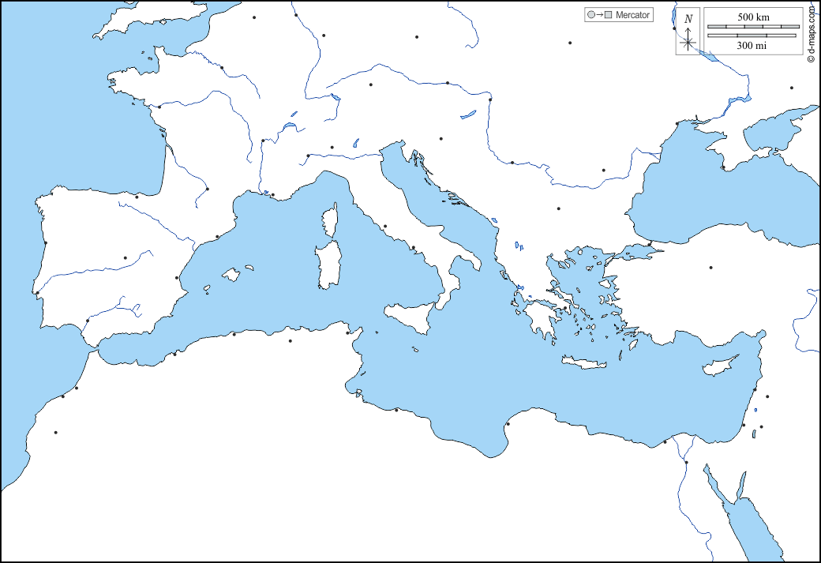
It’s About the Size of the Mediterranean Sea
This big
Notes:
Map source: https://d-maps.com/carte.php?num_car=13552&lang=en

Slide 12
94%
of the garbage is invisible and has settled at the bottom of the ocean

Slide 13
If Fish Get Sick, We Get Sick!
Pollutants in the ocean accumulate in the tissues of marine organisms. Seafood can be contaminated
Ocean pollution affects the fishing industry, leading to economic losses and impacting livelihoods.
Pollution on beaches can lead to waterborne diseases for swimmers.

Slide 14
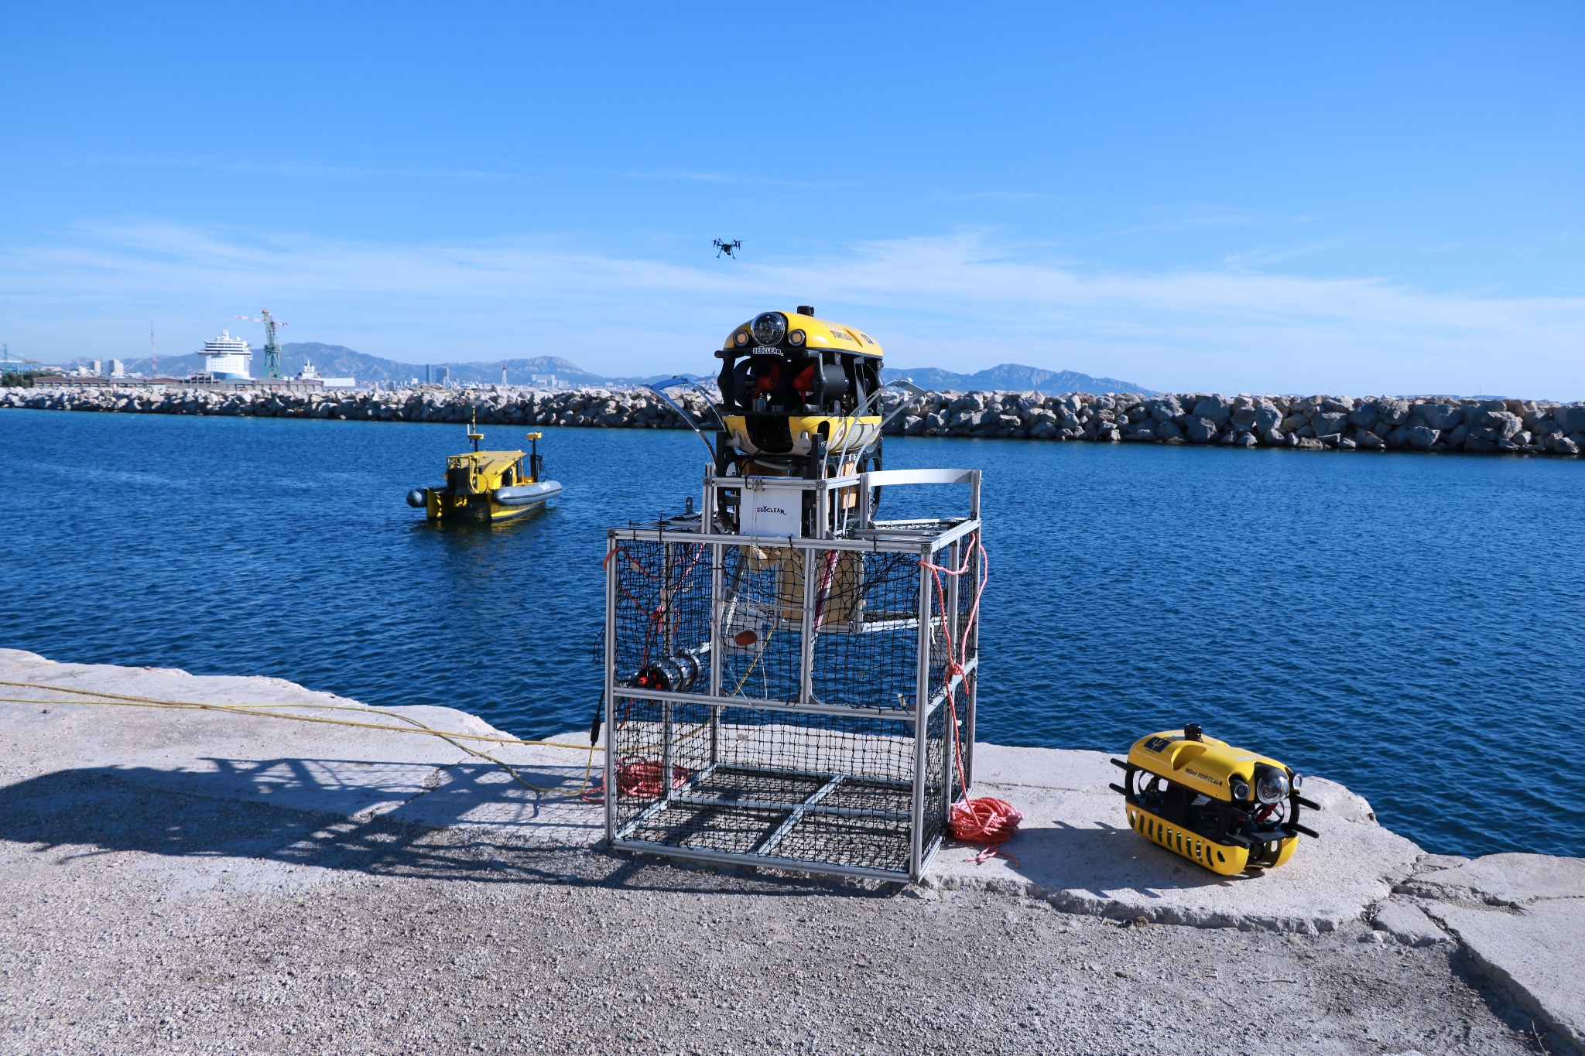
Can Robots Help Us?
SeaClear uses a team of robots, powered by Artificial Intelligence, to clean the bottom of the sea

Slide 15
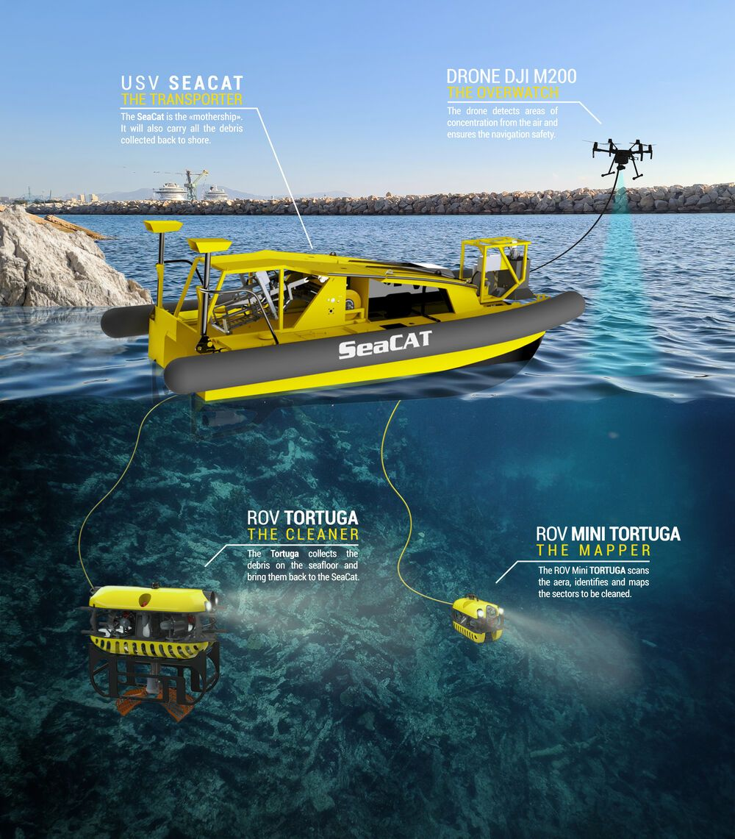
A Ship, a Drone, and an Underwater Robot look for litter.
A second underwater robot collects it and puts it in a smart basket.

Slide 16
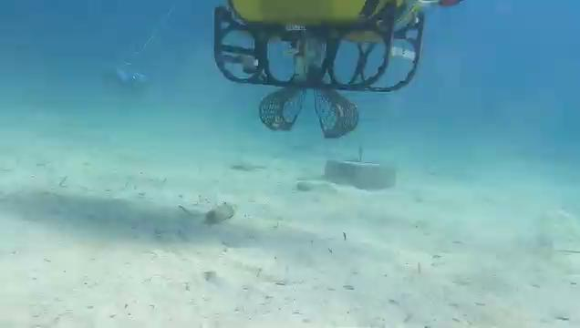

Slide 17
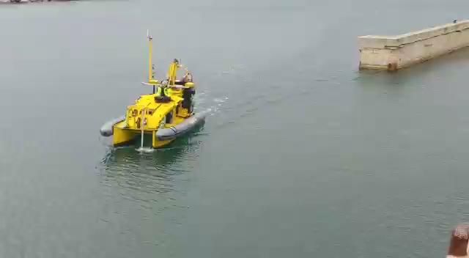
SeaCat, the Mothership
It’s an Unmanned Surface Vehicle (USV)
Acts as the central unit
Scans the sea bottom to look for large litter

Slide 18
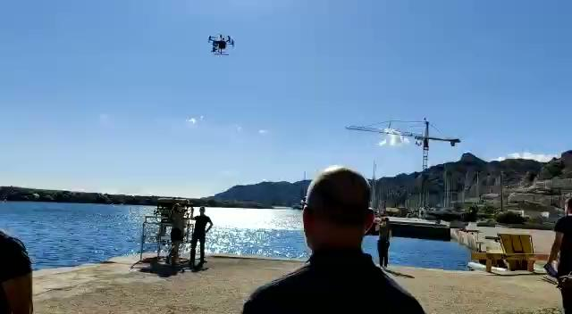
DJI Matrice, the Drone
It’s an Unmanned Aerial Vehicle (UAV)
In clean water, it sees large seafloor litter from above
In murky waters, it looks for surface litter

Slide 19
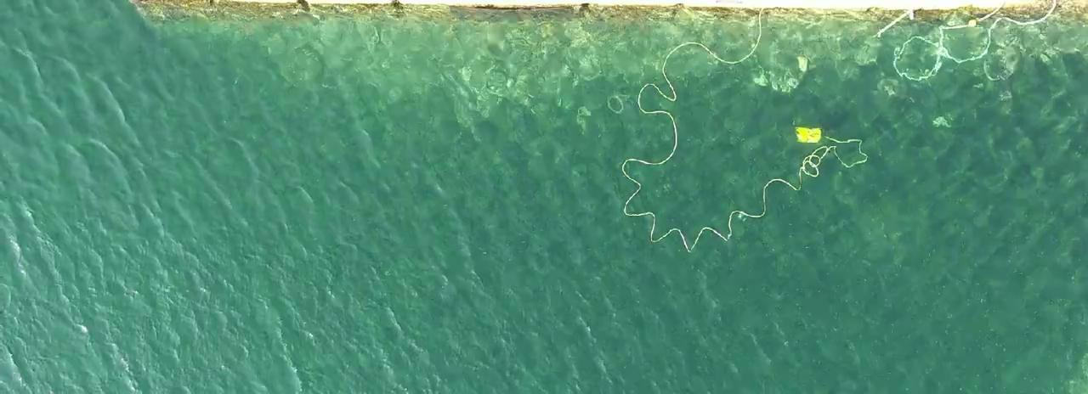
MiniTortuga, the Observation Robot
It’s an Unmanned Underwater Vehicle (UUV)
Uses a camera and a sonar to see litter
It uses AI to identify litter and to find the right path
Knows the difference between litter & sea life!

Slide 20
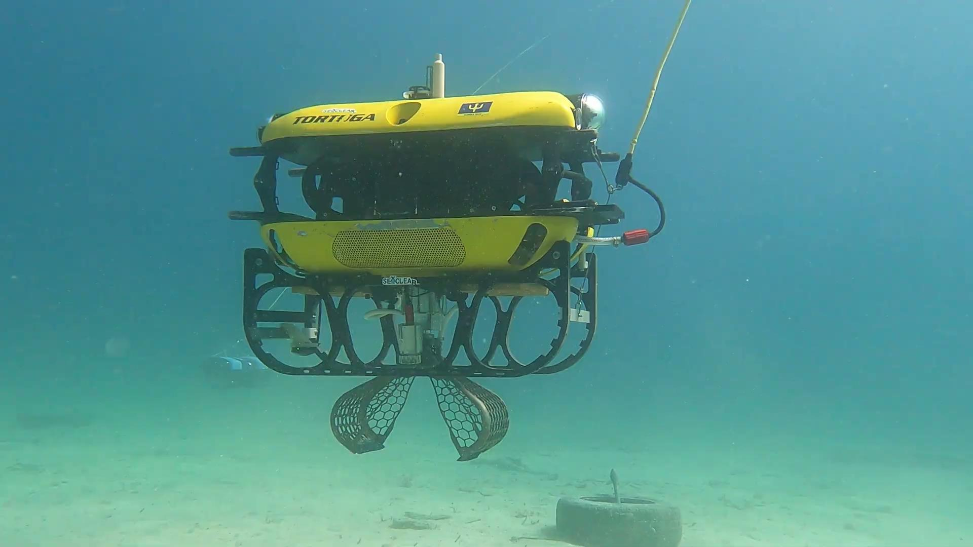
Tortuga, the Collection Robot
Also a UUV
Equipped with a gripper
AI sends it to the litter
Doesn’t catch fish by mistake!

Slide 21
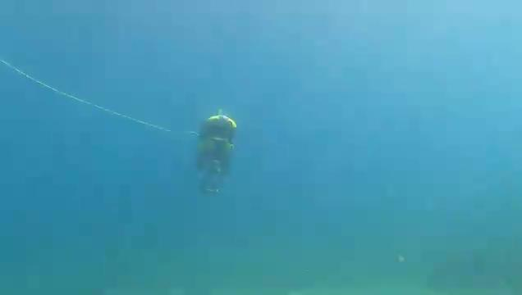
The Collection Basket
It receives litter from the collection robot
Special entrance with bristles stops floating litter from getting back out
Small fish can swim out if they enter by mistake

Slide 22
Does the SeaClear System Work?
Yes! It was tested in a port in Germany and near a beautiful beach in Croatia
It will be improved in another project, SeaClear2.0, which already started!

Slide 23
Quiz Question 1
How long does it take for a plastic cup to break down?
A) 1 year, B) 50 years, C) 150 years, D) 450 years

Slide 24
Quiz Question 2
What percentage of ocean pollution originates from land?
A) 10-20%, B) 40-50%, C) 70-80%, D) 95%

Slide 25
What Can You Do?
Reduce, reuse, recycle - especially plastics
Join beach clean-ups
Support ocean-friendly products

Slide 26
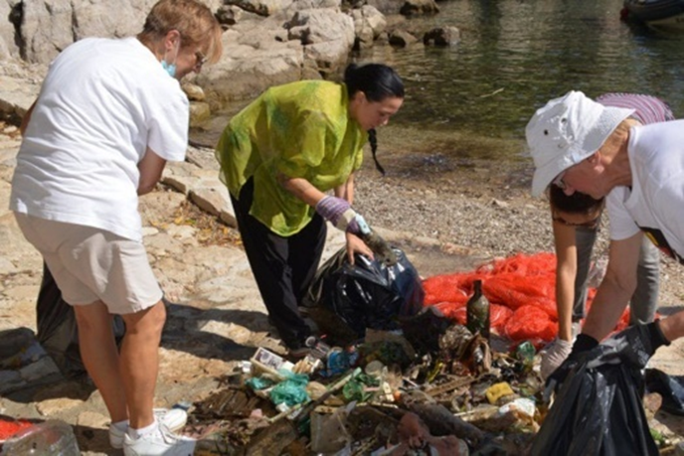
Beach clean-up within SeaClear

Slide 27
What We Learned Today
Ocean pollution affects marine life and humans
Everyone can contribute to reducing ocean pollution

Slide 28
Be a #SeaChampion
Send your comic book dialogue and be featured on SeaClear webpage.

Slide 29
Q&A Time
Time for your questions!
Feel free to ask anything about today's topic

